Slide 1
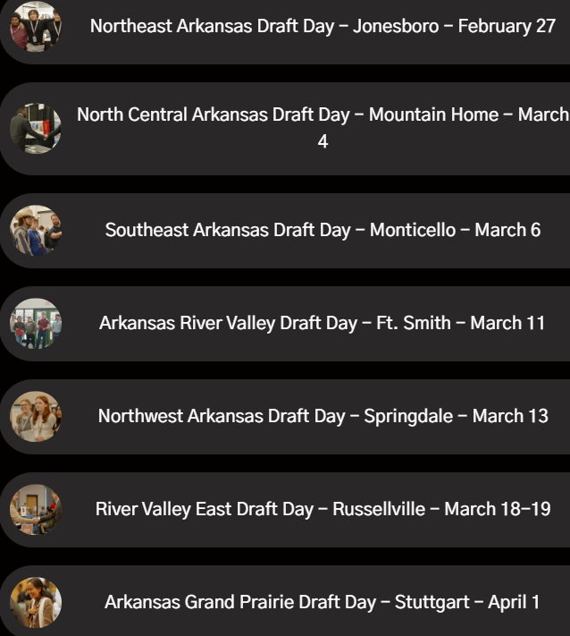
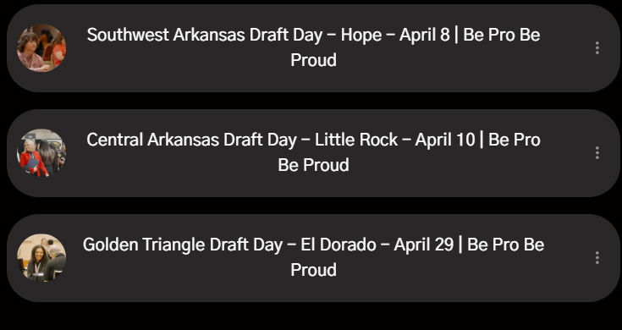
Sarah Guite, Holly Bradley
Brock Harness
Lynda Kay Chapman, Tara Smith, Kinsley Vickers
Brooke Hatcher
Dru Maxwell, Tammy Campbell, Becca Hudman
Brian Faulkner, Brianna Wiggins
Travis Limbaugh
Megan Miller, Elizabeth Wallace, Keathley Arendall, Wilson McKnight, Mary Duren,
Irely Reid
Janet White, Penny Woods

